Slide 1
REMOVE BLACK SPOTS and REDUCE WASTE TO LANDFILL
Mrs Almitra H Patel, MS MIT
Member, Supreme Court Committee
For Solid Waste Management
almitrapatel@rediffmail.com
0 98443 02914
www.almitrapatel.com

Slide 2
KEEP WASTES UNMIXED
WET food fruit flower waste can be managed at home, apartment, colony, Ward or Zone.
CLEAN DRY WASTE has value
Hardly 10% will need to be landfilled.
MANY EXAMPLES OF SUCCESS, WITH PROFIT !

Slide 3
ZERO-WASTE HOME and VILLAGE
Every home has ONLY HALF KG WET WASTE DAILY
In Malnad all homes bury their wet waste around a coconut tree to help it grow.
Near Pune, one village has no waste pickup. All do composting at home, taught in school and college. Prize for best garden grown on compost

Slide 4
ZERO WASTE APARTMENTS AND HOTELS in Kochi

Slide 5
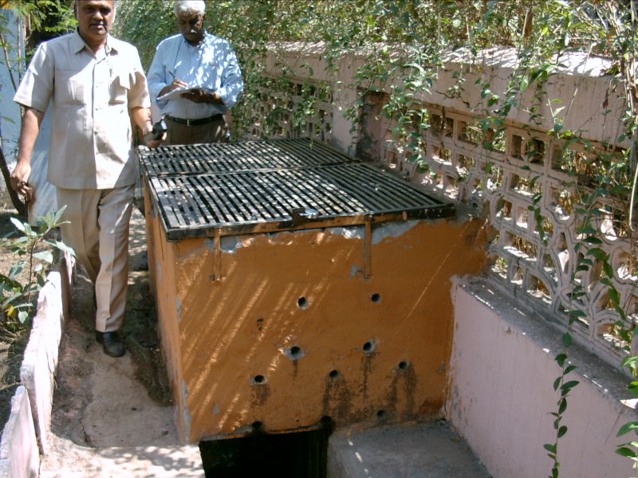
ZERO WASTE COLONY IN MUMBAI

Slide 6
PROFITABLE ZERO-WASTE TOWN : SURYAPET 2004: Rs 1 lac profit p.m. from 1 lac population town

Slide 7
ZERO-WASTE TOWN : KOLAR 25 stacks auctioned for Rs 20,000 in 1 month

Slide 8
ZERO WASTE DISTRICTS: GUJARAT
79 small Towns have each got a vermi-composting unit. Towns are clean and nearby farmers benefit.
We have good vermi experts in Bangalore:
Dr radha Kale now with Mt Carmels College
Khodays
KCDC Staff and workers

Slide 9
CENTRAL COMPOSTING OF MIXED WASTE IS A WASTE OF EFFORT

Slide 10
DECENTRALISED SWM OPTIONS
Stack composting
Vermicomposting
Windrow composting
Biogas Biomethanation
NO BURN OPTIONS LIKE WASTE TO ENERGY !!

Slide 11
Stack composting is self-aerating. Needs no eqpt, power or labour, only 1-3 months’ time to stabilise waste.

Slide 12
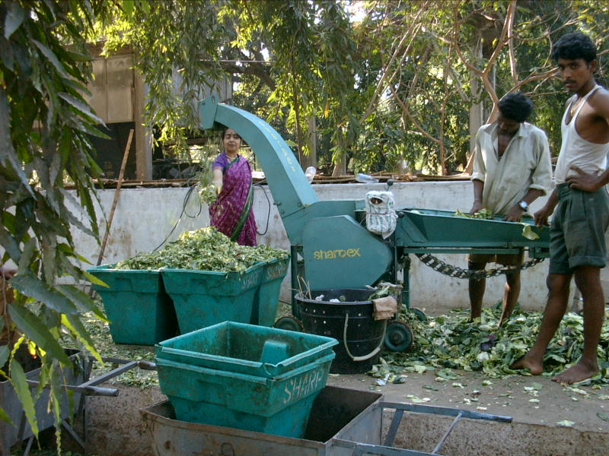
MARKET WASTE SHREDDED FOR VERMICOMPOSTING NEAR WATERTANK

Slide 13
To bio-stabilise waste, first unload it in 2-meter-high long heaps called wind-rows, with space between for air and 4-6 weekly turnings. Use for soil improvement or slope cover

Slide 14
BLACK SPOTS ARE FOR COLLECTING DRY WASTE WHICH HAS VALUE
In Bangalore, one lakh persons live on our Dry Waste :
Waste pickers collect it
Kabadi shops buy it and bale it
Jolly Moholla has all wholesalers
Nayandahalli has all recyclers

Slide 15
USES FOR UNWANTED WASTE
Now, only Unwanted Dry Waste lies in Black Spots or reaches Dry Waste Collection Centres
Thin carrybags can be shredded to make long-lasting tar roads that can give you a good name
Kurkure etc can be converted to diesel in P2F units for Polymer to Fuel

Slide 16
MAKE SURE DRY WASTE IS COLLECTED CLEAN AT THE DOORSTEP
MAKIE SURE THAT UNMIXED WET AND DRY WASTE IS COLLECTED UNMIXED AND TRANSPORTED UNMIXED !
Involve Self Help Groups of Waste Pickers and others for Doorstep Collection

Slide 17
ENCOURAGE DECENTRALISED SWM
Use transport savings to reward the best Wards and Councillors
Let us have a big prize for BEST SUGGESTIONS FROM COUNCILLORS !

Slide 18
ALWAYS AT YOUR SERVICE
almitrapatel@rediffmail.com
98443 02914
www.almitrapatel.com

